Slide 1

Tone Tracer: Decoding the Hidden Meaning
A project submitted in partial fulﬁllment of the requirements for the degree of Bachelor of Technology in Computer Science & Engineering
By- Anshika Mishra (2200560100023)
Ishaan Tripathi (2200560100052)
Riddhisha Srivastava (2200560100091)
Sachin Tripathi (2200560100097)
Under the Supervision of:
Prof. Dr. Anurag Shrivastava (Head of Dept.)
Computer Science & Engineering
Babu Banarasi Das Northern India Institute of Technology, Lucknow, Uttar Pradesh

Slide 2

The Challenge of Subtext
Why Sarcasm is Hard for AI?
Sarcasm represents one of the most challenging problems in natural language understanding. It uses words that convey the opposite of their intended meaning, relying heavily on context, tone, and implicit social cues that humans instinctively recognize.
The Problem
AI struggles to detect when words mean the opposite of what they say
Current sentiment analysis systems frequently misinterpret sarcastic comments, leading to significant errors in data interpretation across social media monitoring, customer feedback analysis, and opinion mining applications.
The Goal
Build a system that decodes hidden meanings accurately

Slide 3



The Toolkit: Building Blocks for Tone Tracing
Python & Data Science
Natural Language Processing
Machine Learning Frameworks
Our primary development environment, leveraging powerful libraries like NumPy, Pandas, and scikit-learn for data manipulation and algorithm implementation.
Advanced NLP techniques for text preprocessing, tokenization, feature extraction, and semantic analysis to understand linguistic patterns.
Keras, TensorFlow, and PyTorch for building and training sophisticated deep learning models capable of learning complex patterns.
Converting smart remarks into smart insights through the power of NLP and ML

Slide 4
Our Structured Approach
Six Key Phases to Build Tone Tracer
Data Acquisition & Preprocessing
Feature Engineering
Gathering labeled datasets and cleaning text through tokenization, stop word removal, and normalization
Extracting linguistic cues and generating word embeddings to capture semantic relationships
Model Selection & Training
Evaluation & Optimization
Experimenting with architectures from linear models to Transformer-based classifiers
Testing performance metrics and fine-tuning for maximum accuracy
Validation & Testing
Deployment & Integration
Rigorous testing on unseen data to ensure generalization
Preparing the system for real-world applications

Slide 5
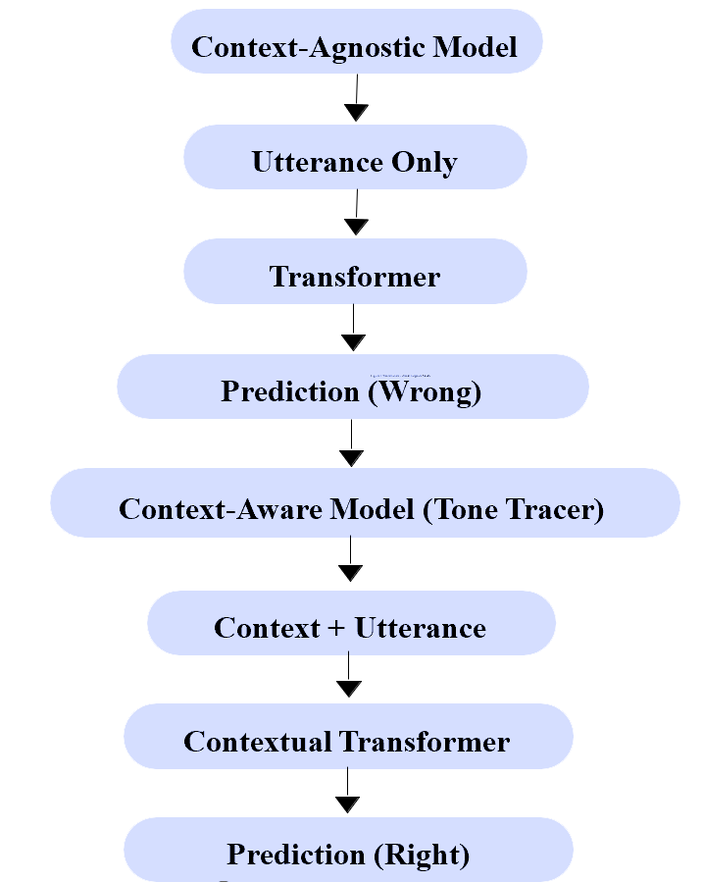
Context-Aware vs Context-Agnostic Models

Slide 6




Tone Tracer System Architecture
Input Layer
Preprocessing
User comment or text sample
Text cleaning & feature extraction
ML Classifier
Output
Trained deep learning model
Classification + confidence score
Expected Performance Targets
Target Accuracy
Precision Focus
Real-time Processing
Aiming for >85% in binary classification tasks
Minimizing false positives to ensure reliable results
Fast inference for practical applications

Slide 7
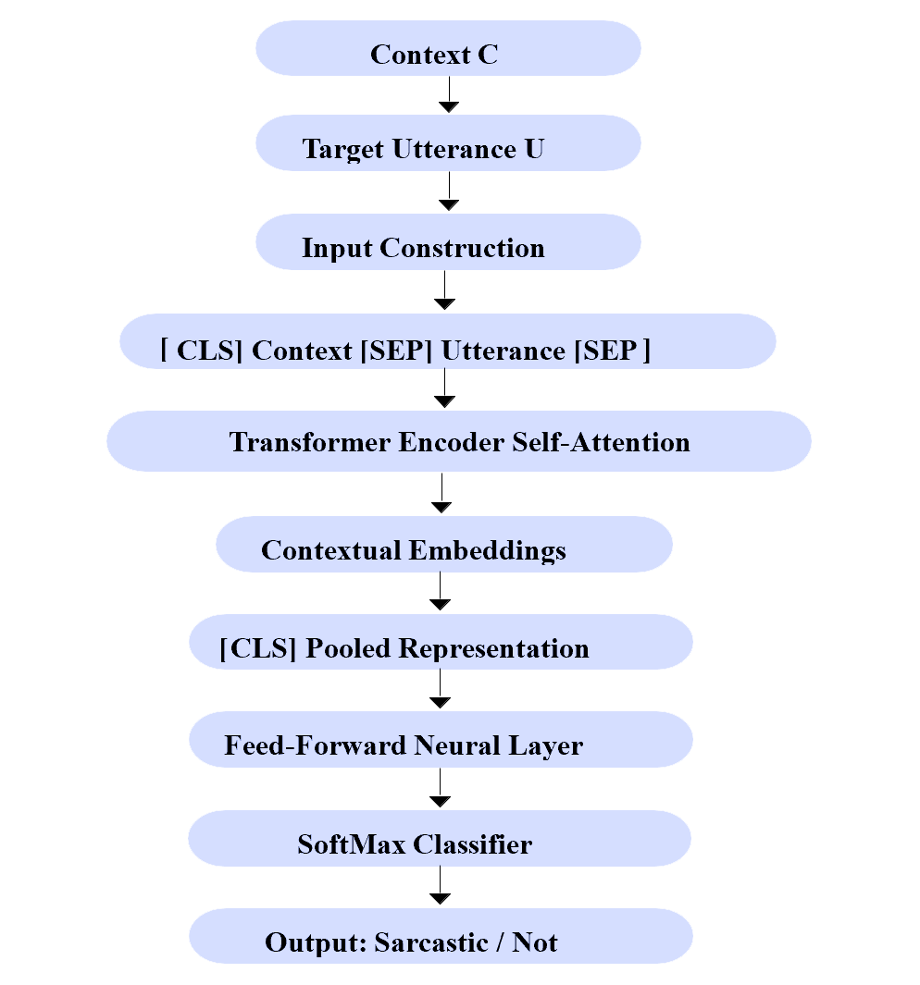
Tone Tracer System Architecture

Slide 8


Current Progress & Roadblocks
✓ Progress Achieved
⚠ Key Challenges
Successfully configured Python development environment with all required NLP and ML libraries
Context Dependency
Handling sarcasm that requires external knowledge or cultural understanding beyond the text itself
Completed initial data exploration and collection from multiple sarcasm-labeled datasets
Data Quality
Ensuring consistent labeling and managing noise in crowdsourced datasets

Slide 9
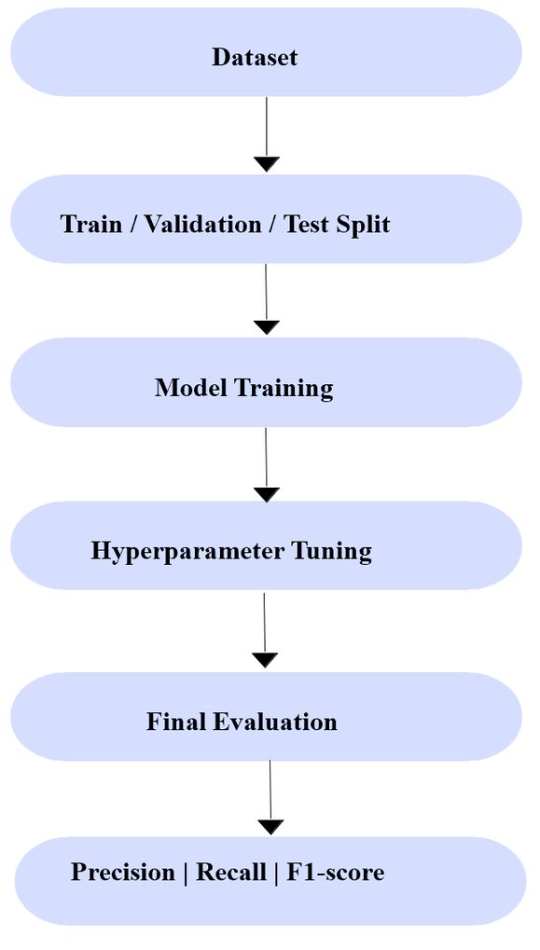
Experimental Evaluation Pipeline

Slide 10

The Path Forward
Making AI Understand Human Intent
The Tone Tracer project addresses a fundamental challenge in computational linguistics: teaching machines to understand when humans don't mean what they say.
By combining sophisticated NLP techniques with advanced machine learning architectures, we're building a system that can decode the hidden layers of human communication.
This isn't just about detecting sarcasm — it's about fundamentally improving how AI systems interpret human language, leading to more accurate sentiment analysis, better human-computer interaction, and smarter automated systems.

Slide 11

THANK YOU!

